Slide 1
Capstone Project
Movie Rental Analysis
By Rishabh Tyagi

Slide 2
OVERVIEW OF MOVIE RENTAL ANALYSIS
Objective: The objective of this project is to create a comprehensive Power BI dashboard utilizing the Sakila Movie Rental Database. The dashboard aims to provide valuable insights to understand customer behavior and preferences, optimize film inventory management, evaluate staff performance and store operations, enabling data-driven decision making and strategic planning.
Analysis Scope: The analysis will delve into different facets of the movie rental process, covering areas such as film rentals, film performance, store operations. It will entail historical rental data, actor and genre contributions, and store performance metrics.. The dataset will include comprehensive information from various movie rental stores and the rental history of diverse films.

Slide 3
Goal: The primary goal of this Power BI dashboard is to provide a comprehensive overview of the movie rental company's operations. It aims to offer actionable insights to optimize film rentals, enhance collaboration with actors and genres, improve store distribution strategies, and identify opportunities for growth and efficiency in the competitive movie rental market.
Report & Presentation: The final deliverable will consist of a detailed report describing the data sources, data modeling methodologies, and data cleansing processes used in creating the Power BI dashboard. The report will also include a step-by-step guide on how to interpret the insights and use the dashboard for decision-making. The presentation will showcase the key findings, visualizations, and actionable recommendations derived from the dashboard's analysis. The Power BI dashboard, along with the report and presentation, will serve as a powerful tool for the rental company's stakeholders. It will empower them to make informed decisions, optimize rental sales strategies, and enhance the overall business performance in the competitive publishing landscape

Slide 4
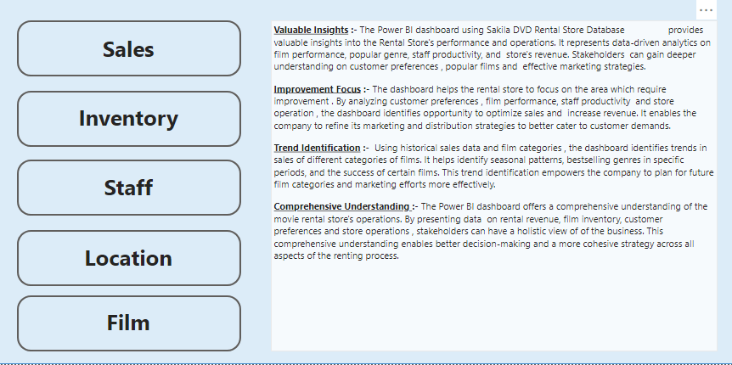
DASHBOARD EXECUTIVE SUMMARY

Slide 5
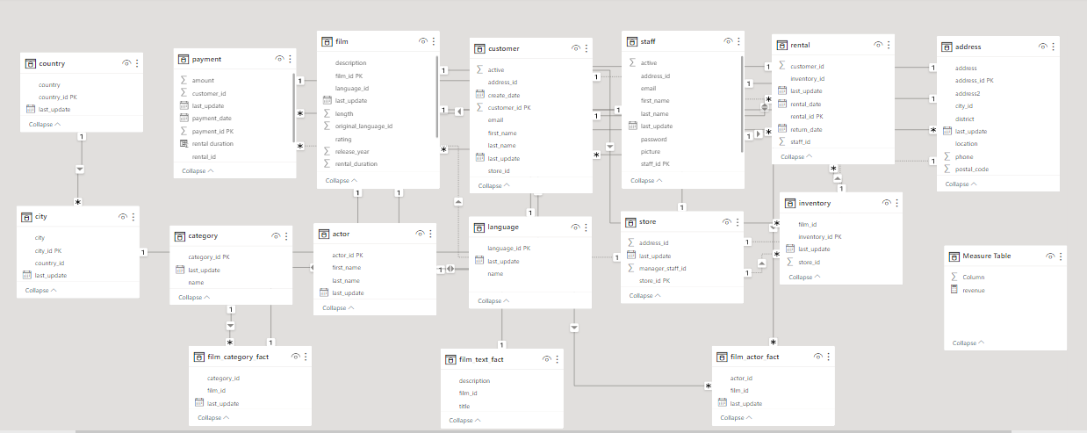
ENTITY RELATIONSHIP DIAGRAM

Slide 6
POWER BI DASHBOARDS
WITH PROBLEM STATEMENTS

Slide 7
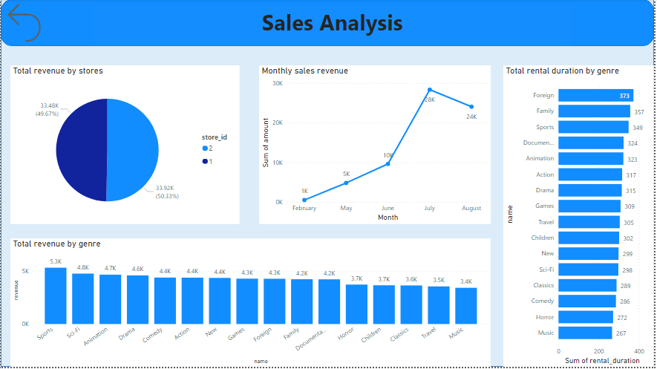
SALES ANALYSIS

Slide 8
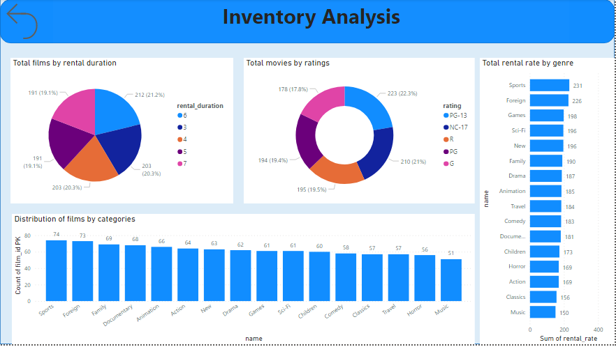
INVENTORY ANALYSIS

Slide 9
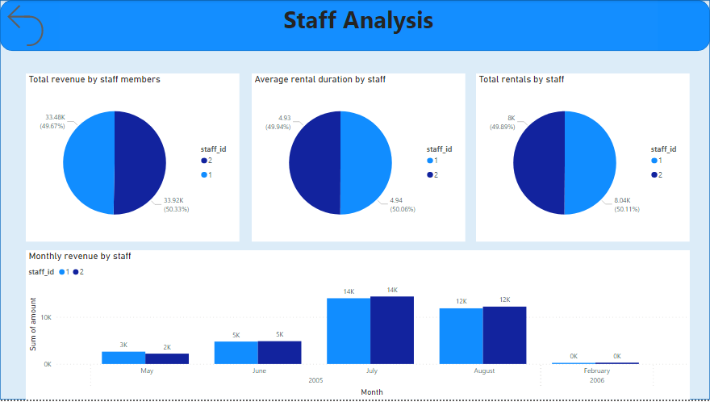
STAFF ANALYSIS

Slide 10
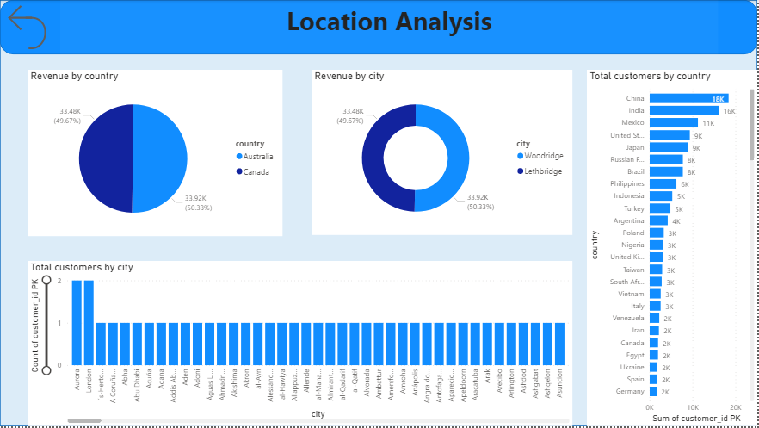
LOCATION ANALYSIS

Slide 11
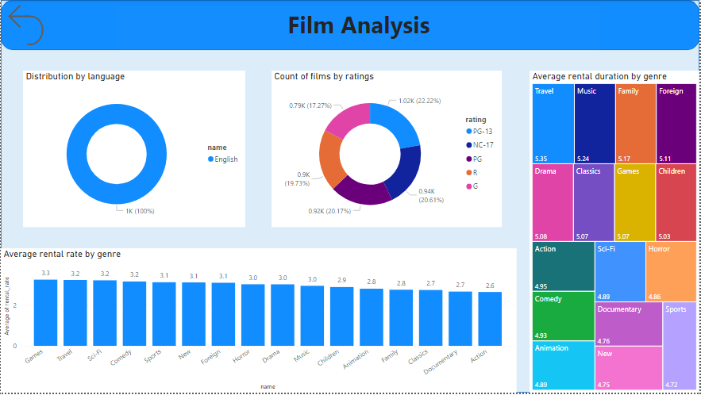
FILM ANALYSIS

Slide 12
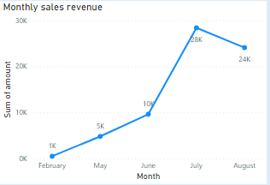
How does the sales revenue vary by month?
Here, we can see that the sales in the month of February were the lowest with the numbers approximately being 1000 and with time we saw a tremendous growth in the sales with July being the highest contributing month. The sales dropped in the very next month from 28k to 24k.

Slide 13
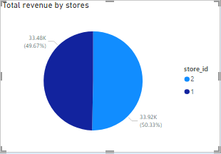
How does the sales revenue vary by different stores?
The revenue generated by the two stores under consideration is almost identical as visible from the pie chart. Store 1 was responsible for contributing 49.67 % of the total sales and Stores 2 did 50.33% with both the stores contributing equally to the business.

Slide 14
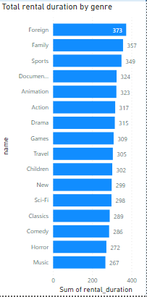
How does the rental duration of the movies rented vary by genre?
The cumulative rental duration in days for every genre of the movie is presented in the bar chart. As seen, the Foreign genre was rented for the longest duration followed by Family and Sports. The least duration was seen with the categories like Music and Horror.

Slide 15
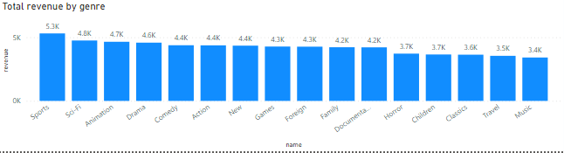
How does the total revenue vary by genre?
The highest gross revenue generated was more than USD 5000 by the only genre i.e. Sports followed by Sci-Fi and Animation with 4.8K and 4.7K respectively. The category with least gross revenue was Music with 3.4k and Travel with 3.5K

Slide 16
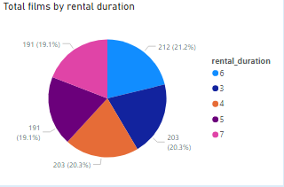
What is the distribution of films by rental duration?
The pie chart show the distribution of the inventory according to the number of days the films were rented for. The biggest portion of the pie represent the number of films that were rented for 6 hours. The count is 212 films. Similarly, the count is 203 for both 3 and 4 hours.

Slide 17
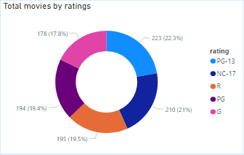
How does the inventory vary by film rating?
There are multiple ratings and the inventory can be categorized under them basis the audience movies are best suited for. The highest number of films fall under PG-13 rating with 223 films followed by 210 films under NC-17 rating and so on.

Slide 18
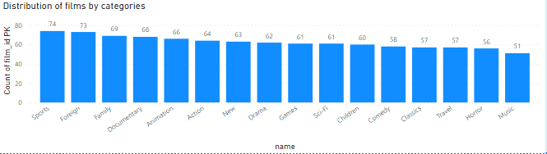
What is the breakdown of film categories in the inventory?
The breakdown of the inventory as per the film genre is shown in the column chart where the maximum number of films in a category belong to Sports followed by Foreign. The least number of films a category has in the stores is Music.

Slide 19
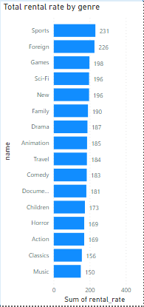
How does the total rental rate vary by genre?
The Sports category has the highest rental rate amongst all the categories of the films. It is followed by Foreign and Games. The last spot in this order is occupied by Music category with the least rental rate i.e. 150

Slide 20
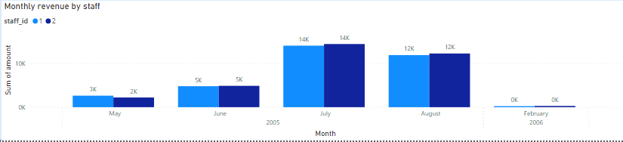
What is the monthly revenue generated by each staff member?
The contribution by the only 2 staff members has been very competitive every month. The month of May saw a difference in the revenue generation as Staff id 1 contributed slightly higher than the other else the contribution has been identical of the rest of the year with 0 sales in February 2006.

Slide 21
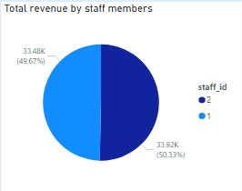
What is the % contribution of each staff member towards total revenue?
The only 2 staff members have contributed almost equally towards the total revenue for the time period in consideration with Staff Id 1 with 49.67% and Staff Id 2 with 50.33%

Slide 22
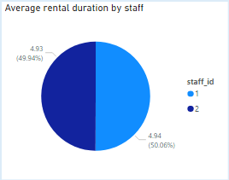
What is the average rental duration as per Staff members?
This chart helps us understand the average duration for which the Staff members rented out the movies with different durations. The average hours for the Staff Id 1 was 4.93 hours and for Staff Id 2 was 4.94 hours which is almost similar to one another.

Slide 23
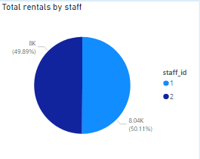
Find the total number of rentals by Staff?
The total number of rentals were also similar for both the staff ids with 8000 for staff id 2 and 8040 for staff id 1 contributing to 49.89 % and 50.11 % respectively to the total number of rentals.

Slide 24
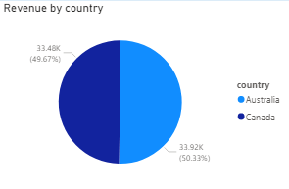
How does the rental revenue vary by country?
The two country under consideration for the sales are Australia and Canada where the sales happened. It can be inferred that the two stores are located one in these 2 countries hence the business done by the stores is the individual business for the country.

Slide 25
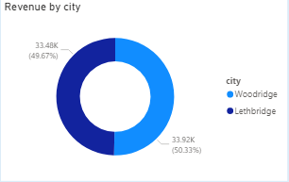
How does the rental revenue vary by cities?
The cities were namely Woodbridge and Lethbridge with the sales from the two stores being same as discussed earlier, 50.33% for Woodbridge and 49.67% for Lethbridge

Slide 26
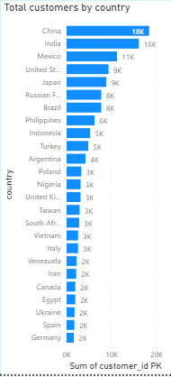
What is the distribution of the customers by country?
The highest number of customers belong to China, India and Mexico with more than 10k customers individually whereas Germany, Spain and Ukraine are some amongst the countries that have around 2k customers.

Slide 27
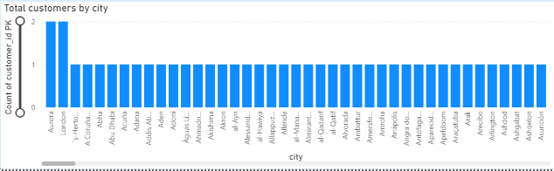
What is the distribution of the customers by city?
The bar chart shows the distribution of the customers by city with Aurora and London having the highest number of customers and the remaining cities have almost similar number of customers that are too low when compared to the aforementioned cities

Slide 28
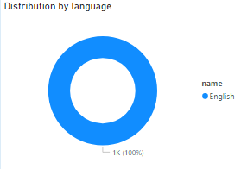
What is the distribution of films by language?
There is only one language in which the films were rented out by the customers hence the blue donut and 100% distribution to English language.

Slide 29
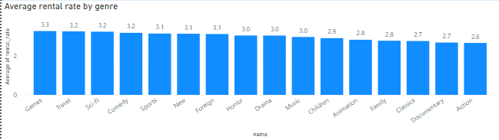
Which film categories have the highest rental rates?
The average rental rate was seen the highest for the Games and the lowest for the Action. There were many genres that shared the similar average rental rate like Horror and Drama with 3.0

Slide 30
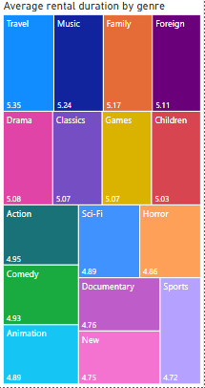
How does the average rental duration vary by film category?
Travel and Music respectively are the top two genres with the highest average rental duration with Sports, New and Documentary grabbing the lowest spot in the list.

